Slide 1
UNIVERSITY OF PADOVA ________________________________________________________ MSc in Computational Finance Project: Yield Curve model calibration Ibrahim Uali Riccardo Caruso Enrico Berto Elisa De Colle ________________________________________________________ February 22, 2024

Slide 2
Index
X
xx
xxx
xxxx
xxxxx

Slide 3
The Project: Data Collection
1 year
2 years
3 years
5 years
10 years
US
Germany
Portugal
South Korea
BONDS
MATURITIES

Slide 4
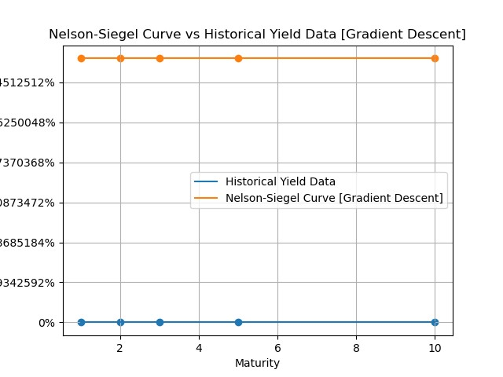
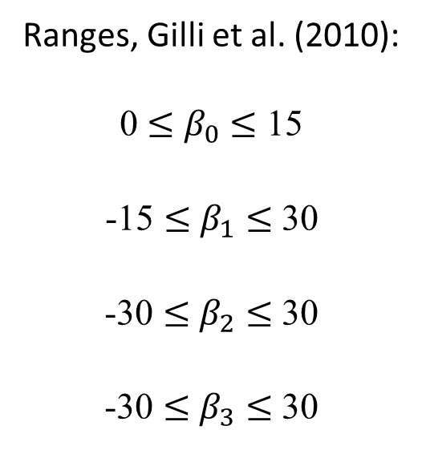
The Gradient Descent method
Initial parameters:
Ranges, Gilli et al. (2010):
0 $≤$ $β_{0}$ $≤$ 15
-15 $≤$ $β_{1}$ $≤$ 30
-30 $≤$ $β_{2}$ $≤$ 30
-30 $≤$ $β_{3}$ $≤$ 30
From these ranges we performed
several iterations in order to find the optimal initial combination. We did it be looking at the plots.
Example with all parameters set to 0.1

Slide 5
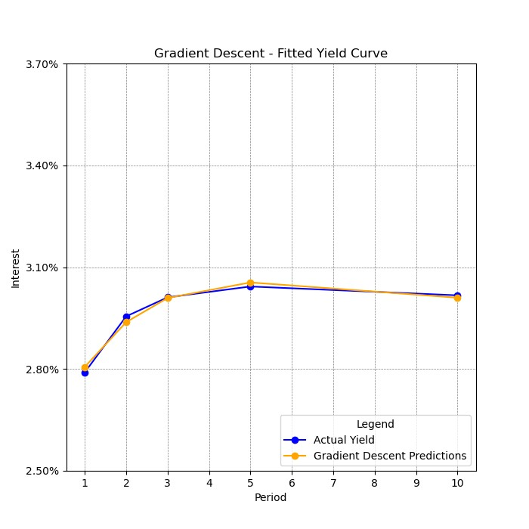
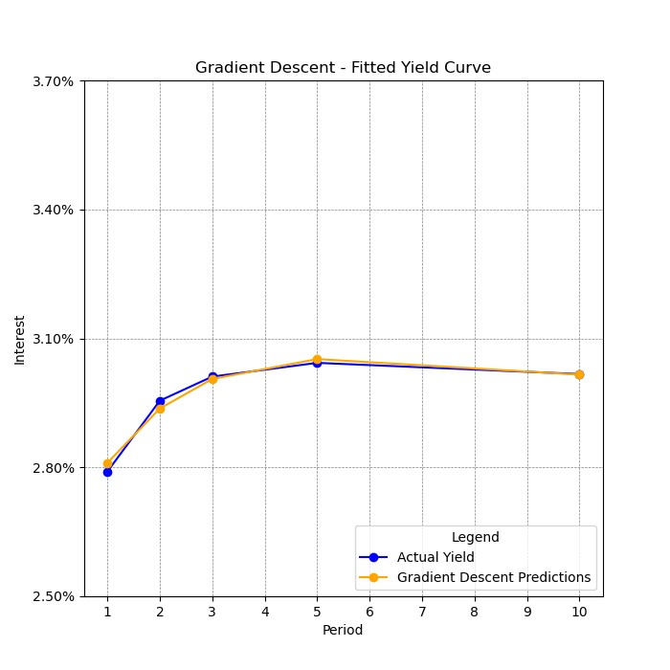
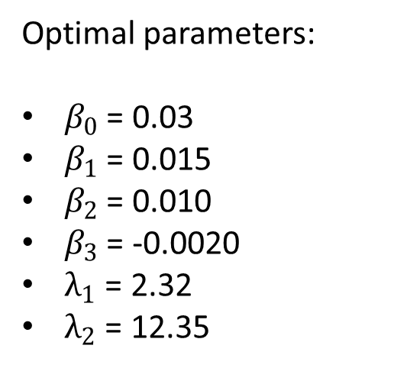
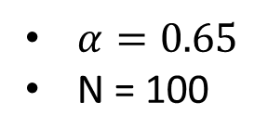
The Gradient Descent method
US:
We present the example of US. The behaviour of the Gradient Descent method is similar for every countries, but parameters and plots are different due to economic conditions.
Optimal parameters:
$β_{0}$ = 0.03
$β_{1}$ = 0.015
$β_{2}$ = 0.010
$β_{3}$ = -0.0020
$λ_{1}$ = 2.32
$λ_{2}$ = 12.35
$α=0.65$
N = 100

Slide 6
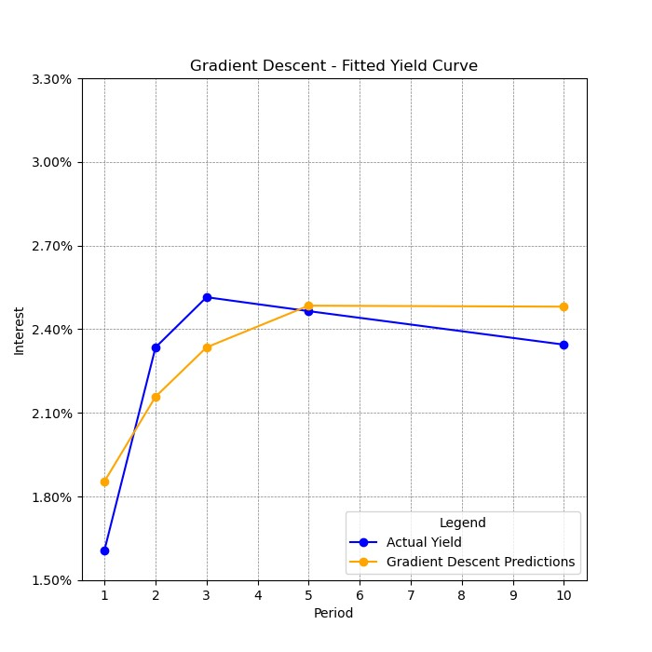
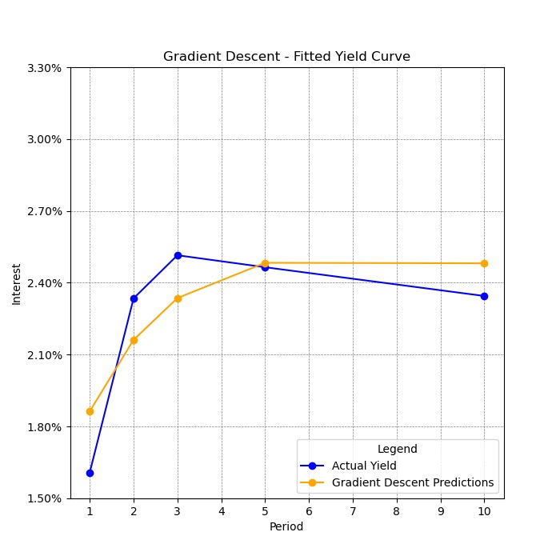
The Gradient Descent method
US:
Bonds with high volatility

Slide 7
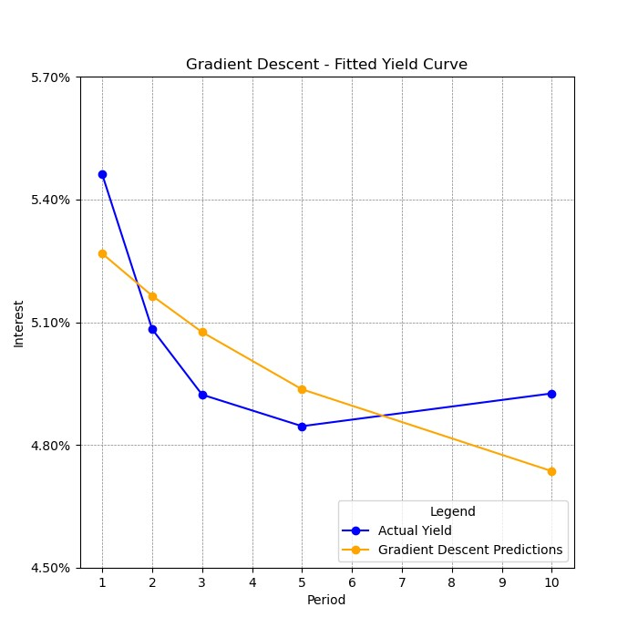
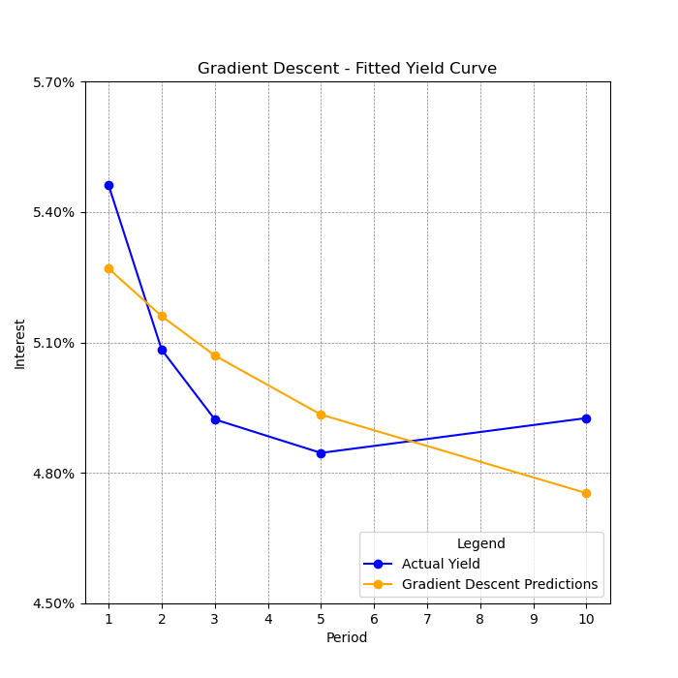
The Gradient Descent method
US:
Inverted yields curves

Slide 8
Thanks for the attention!
Notes:
Ringrazio i presenti

